Slide 1

AI in Smart Parking

Slide 2



Agenda
Overview
Introduction
Procedures
Benefits
Drawbacks
Future Scope
Conclusion

Slide 3




Overview
The PowerPoint presentation on AI in smart parking will cover the use of artificial intelligence (AI) in optimizing and improving the parking experience for drivers. The presentation will begin with an introduction to the challenges of traditional parking systems and how smart parking can address these challenges.

Slide 4

Introduction
Today's presentation will focus on the integration of Artificial Intelligence (AI) in the development of smart parking systems. In recent years, the growing number of vehicles on the road has led to an increase in the demand for parking spaces, especially in urban areas. As a result, traditional parking systems have become outdated and ineffective in addressing the needs of drivers.
Smart parking is an innovative solution that seeks to optimize parking space utilization and enhance the parking experience for drivers. With the advent of IoT and AI technologies, smart parking has evolved to provide real-time data and analytics that can help drivers find available parking spaces quickly and conveniently.
This presentation will explore the various ways that AI can be used in smart parking systems to improve parking availability, reduce traffic congestion, and enhance revenue generation. We will discuss the various technologies used in smart parking and how AI can be leveraged.

Slide 5
Procedures
Implementing AI in smart parking involves several procedures, some of which are:
Data Collection: To implement AI in smart parking, data collection is the first and foremost step. This involves collecting data on parking lots, the availability of parking spaces, and vehicle movements in and out of the parking lot. Sensors, cameras, and other IoT devices can be used to collect this data.
Data Processing: After data collection, the next step is to process the data collected. This involves cleaning and organizing the data, as well as analyzing it to identify patterns and insights.
AI Model Development: The next step is to develop an AI model that can analyze the data and make decisions based on it. This may involve using machine learning algorithms to train the model, or developing a neural network to process the data.

Slide 6
Procedures
Integration with Smart Parking System: Once the AI model has been developed, it needs to be integrated with the smart parking system. This involves connecting the AI model to the sensors and other devices in the parking lot.
Testing and Optimization: After integration, the system needs to be tested and optimized to ensure that it is working effectively. This may involve making adjustments to the AI model or the smart parking system itself.
Deployment and Maintenance: Once the system has been tested and optimized, it can be deployed for use. However, it is important to continue monitoring and maintaining the system to ensure that it continues to work effectively over time.

Slide 7
Techniques
YOLO
VEHICLE TRACKING
It is a deep learning approach of the object detection
is a real-time object detection system based on Convolutional Neural Network (CNN).
It was proposed to deal with the problems face by the object recognition.
The system identifies vehicles using their unique ID, which is passed from the entrance management system. .
It checks whether it has parked in the correct parking space by comparing real-time images with stored images of the parking spaces.

Slide 8
Techniques
ACCIDENT DETECTION
VEHICLE NUMBER RECOGNITION
If an accident occurs, it is detected by the tracking application and stored in the database, and an alarm is sent to the driver's smartphone app.
When the vehicle is about to leave the parking lot, the entrance management system checks the database to see if the vehicle was involved in an accident. If so, the gate does not open and the manager is notified.
the focus is not on license plate recognition, and a simpler Optical Character Recognition (OCR) method using Open CV was used to extract characters from images instead of deep learning technology.

Slide 9
Benefits
There are several benefits of using AI in smart parking, including:
Increased Efficiency: AI can help optimize parking space usage by analyzing data in real-time and making decisions about which spaces are available or occupied. This can help reduce the time it takes for drivers to find a parking space, and minimize the number of vehicles circling around the parking lot, looking for a spot.
Cost Savings: By optimizing parking space usage, AI can also help reduce costs associated with managing parking facilities. This can include reducing the number of attendants required to manage parking lots, as well as minimizing the need for expensive equipment or infrastructure.

Slide 10
Benefits
Improved Customer Experience: By reducing the time it takes to find a parking space, AI can improve the overall customer experience. This can help increase customer satisfaction and loyalty, and may even lead to increased revenue for businesses that rely on parking as part of their operations.
Reduced Congestion: By optimizing parking space usage, AI can help reduce congestion in and around parking lots. This can help improve traffic flow and reduce emissions from vehicles that are stuck in traffic.
Increased Safety: AI can also help improve safety in parking lots by monitoring for potential hazards, such as pedestrians or other vehicles, and alerting drivers to potential risks.

Slide 11
Drawbacks
While there are several benefits of using AI in smart parking, there are also some potential drawbacks to consider, including:
Technical Issues: AI relies on complex algorithms and models to make decisions, which can be prone to technical issues or errors. This can lead to incorrect decisions about parking space availability, which can frustrate drivers and reduce the efficiency of the parking system.
Cost: Implementing AI in smart parking can be expensive, requiring significant investment in sensors, cameras, and other infrastructure. This can make it difficult for smaller parking facilities or businesses to justify the cost of implementation.

Slide 12
Drawbacks
Data Privacy: Collecting and processing data in real-time can raise concerns about data privacy and security. Parking facilities must ensure that they are collecting and processing data in accordance with relevant regulations, and that they are taking steps to protect sensitive data from unauthorized access or theft.
Maintenance: AI systems require regular maintenance and updates to ensure that they continue to function effectively over time. This can add additional costs and complexity to the management of parking facilities.
User Acceptance: Some drivers may be hesitant to rely on an AI system to find a parking space, preferring to rely on their own instincts and experience. This can make it challenging to encourage widespread adoption of AI-powered parking systems.

Slide 13
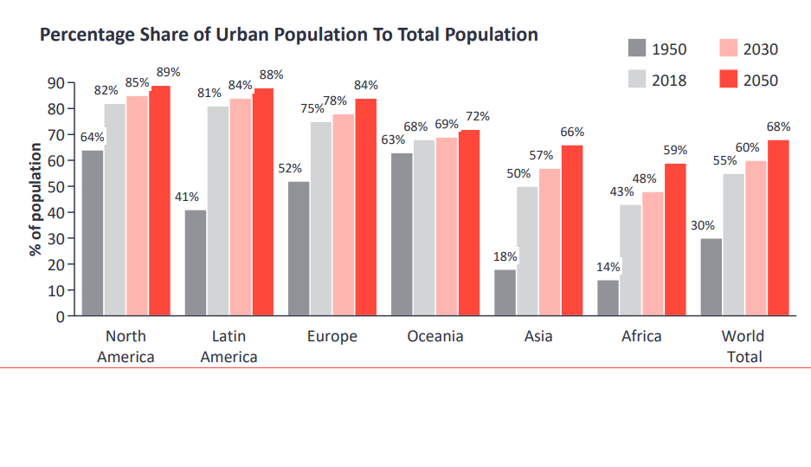
Future scope
According to the United Nations’ Report on World Urbanization Prospects: The 2018 Revision, the percentage of people living in urban areas globally is expected to reach 68% by 2050 or 6.7 billion, up from 55% in 2018 and just 30% in 1950. This translates to a rising number of vehicles on the road and with it a rising demand for parking spaces.

Slide 14
Future scope
However, most cities are constrained by the amount of space they can allocate to the road network including parking spaces. This has resulted in worsening traffic congestion, limited availability of parking spaces and higher emission of CO2 in many urban environments. Leveraging smart parking solutions will help address these challenges and improve the quality of life of people living in urban areas.
Increase in quality of life of people brings more and more challenges especially for the people living in developed and industrial zones. This makes the future scope of AI in smart parking even more visible.

Slide 15
How’s the future ?
The future scope of AI in smart parking is vast and exciting, as new technologies and innovations continue to emerge. Some potential areas of development and advancement include:
Predictive Analytics: AI can be used to predict parking demand based on factors such as weather, events, and time of day. This can help parking lot operators plan for increased demand and optimize parking space usage.
Autonomous Vehicles: As autonomous vehicles become more common, AI can be used to guide these vehicles to available parking spaces, optimizing parking space usage and reducing congestion.

Slide 16
How’s the future ?
Real-Time Navigation: AI can be used to provide real-time navigation to drivers, guiding them to available parking spaces and minimizing the time spent searching for a spot.
Smart Payment Systems: AI can be used to facilitate smart payment systems, allowing drivers to pay for parking using their mobile devices or other digital payment methods.
Sustainability: AI can be used to promote sustainability in smart parking, by optimizing parking space usage and reducing congestion, thereby reducing emissions from vehicles.

Slide 17
Timeline
2016
The city of San Francisco implemented an AIpowered parking management system called SFPark to optimize parking space usage and reduce congestion.
2018
The city of Amsterdam launched a pilot project for an AI-powered parking system, using machine learning algorithms to predict parking demand and optimize parking space usage
2019
Dubai launched an AI-powered smart parking system, using sensors and machine learning algorithms to guide drivers to available parking spaces and facilitate payment through mobile devices
2020
2021
The city of Helsinki announced plans to implement an AI-powered parking system in its downtown area, using sensors and machine learning algorithms to optimize parking space usage and reduce congestion.
Singapore implemented an AI-powered parking system in several of its public housing estates, using computer vision technology to detect available parking spaces and guide drivers to them.

Slide 18
How’s the future ?
Integration with Smart Cities: As more cities become "smart," AI-powered parking systems can be integrated with other smart city technologies, such as traffic management systems and public transportation, to optimize the overall mobility experience for residents and visitors.
Overall, the future of AI in smart parking is bright, as new technologies and innovations continue to emerge, offering new opportunities to improve the efficiency, cost-effectiveness, and overall experience of parking facilities.

Slide 19

The AI is not about replacing humans. It's about amplifying our abilities and making us better at what we do.
Satya Nadella

Slide 20

Summary
AI in smart parking involves the use of artificial intelligence technologies to optimize the management of parking facilities. By analyzing real-time data and making decisions about parking space availability, AI can help reduce congestion, improve efficiency, and enhance the overall customer experience of parking facilities. While there are potential drawbacks to using AI in smart parking, such as technical issues and cost, the future scope of AI in this field is vast and exciting, offering new opportunities for innovation and development.

Slide 21


Thank You
ABHI MAGGON
KOUSHIK MANIKANTA
AMAN SINGH

